Slide 1
CDA 541 Statistical Data Mining I
Final Project
YouTube Video URL : https://youtu.be/FE3xPpNFS_I

Slide 2
Predicting Fire alarm Trigger using Smoke Detection Data
The goal of this project is to predict the trigger of the fire alarm using the smoke data. We are having 60k observations and 15 features in the data to predict the outcome. These features include the amount of chemical compounds present in the air along with some properties like Humidity , Pressure etc.
We are going to build multiple classification models, check their performance on this dataset , to determine the best model for this data. Classification Models include - Logistic Regression , KNN , Decision Tree , Random Forest , ADA Boost , Gradient Boost . Best model will be proposed based on the train and test error and accuracy of the model.

Slide 3
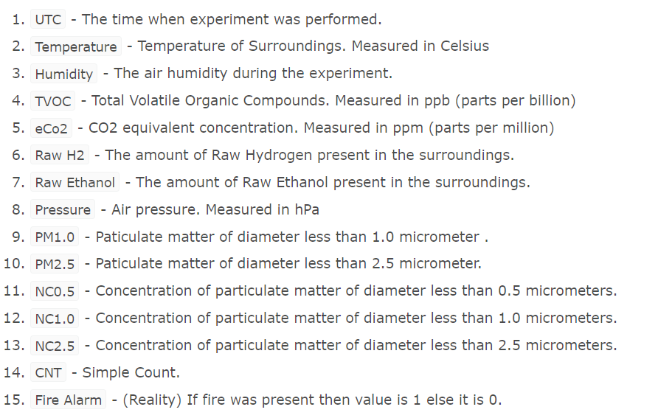
Dataset Overview

Slide 4
Data Exploration
There are 62,630 observations and 15 predictor variables and 1 response variables . All variables are either Integer or Float and are continuous variables . There are no categorical variables in this dataset . There are no rows which have null values and no duplicate records as well . This dataset is very clean we can proceed with EDA .
There are some columns which we can drop in the data .
UTC - This column tells us the time which data point is recorded , which has no effect on the response variable
Unnamed: 0 , CNT - These are index columns , so we can remove these as well
Temperature, PM , NC values are on different scales . We need to scale the data when we are modelling

Slide 5
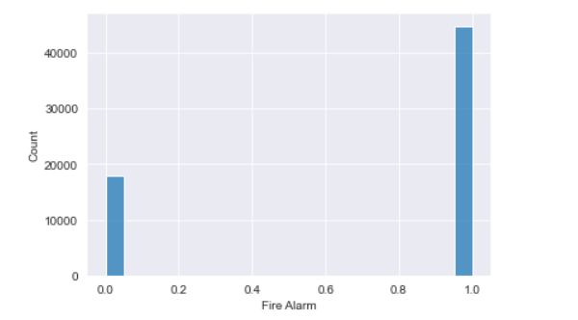
EDA
From 60k observations we see only 18k observations belong ‘No Fire’ and remaining 40k observations ‘Yes Fire’
This dataset looks imbalanced, but we will continue with
our analysis and see if this is having any effect on the
models. If we see underfit and most of ‘No Fire’ data
is predicted as ‘Yes’ we will balance the data and build
models again.
We will check the correlation of response variable with the predictor variables

Slide 6
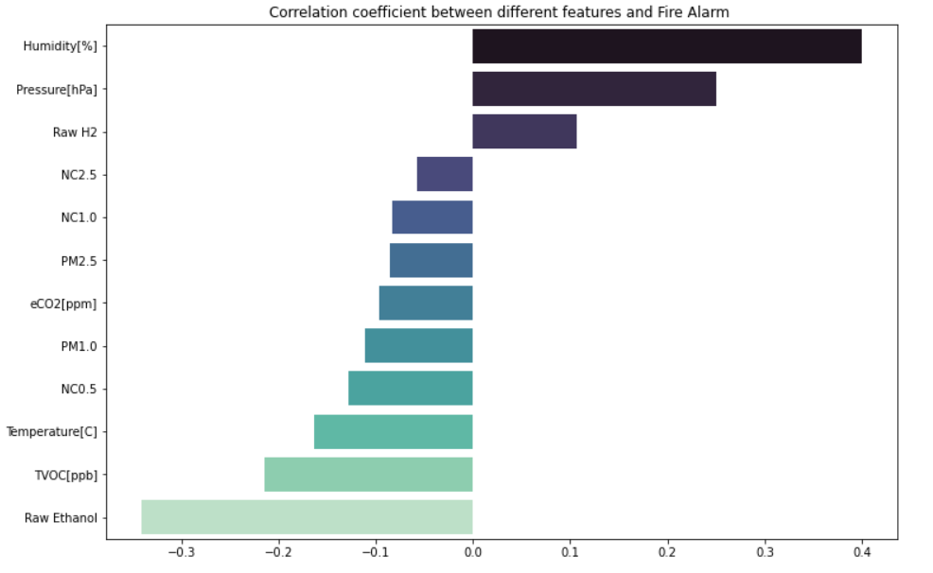
Humidity and Pressure are having high positive correlation with the response . Raw Ethanol and TVOC are having high negative correlation.

Slide 7
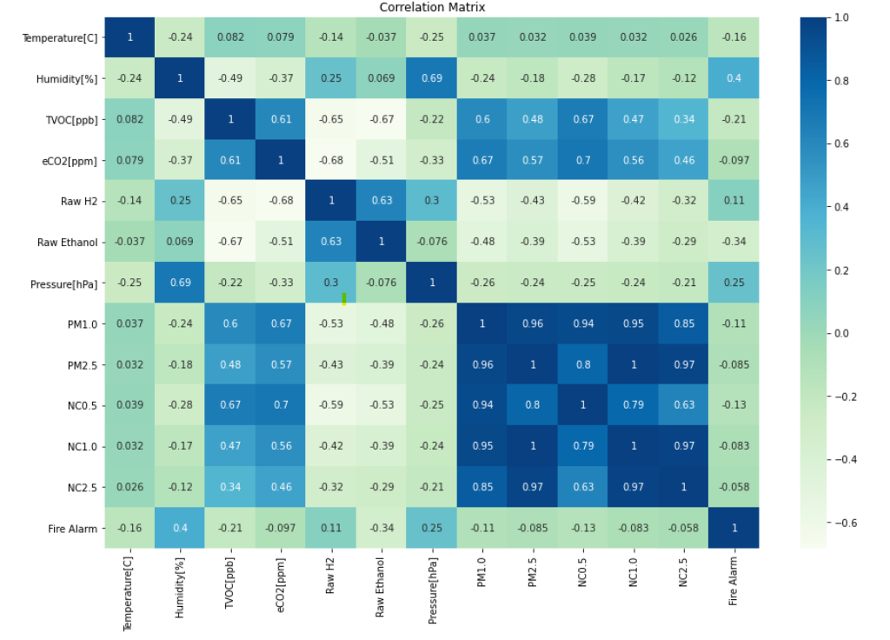
Correlation matrix to see how predictor variables interact with each other
We could see all PM and NC values are very highly correlated . Humidity and Pressure are moderately correlated as well.

Slide 8
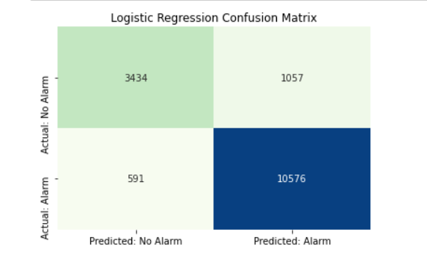
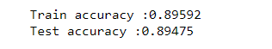
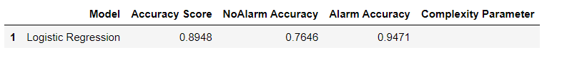
Modelling
Scaling the data
We have used MinMaxScaler() from sklearn to transform the features to be in range 0 to 1
Logistic Regression Results

Slide 9
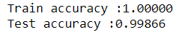
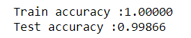
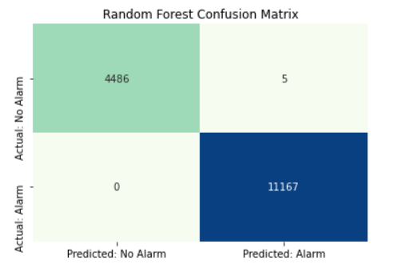
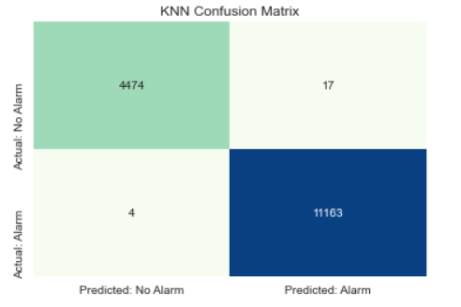
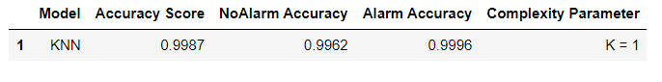
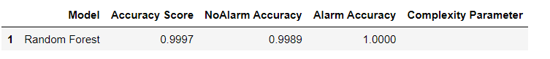
KNN
Random Forest
For KNN , we could see the best accuracy for training and test data for K=1

Slide 10
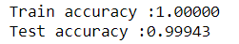
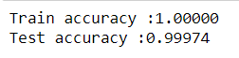
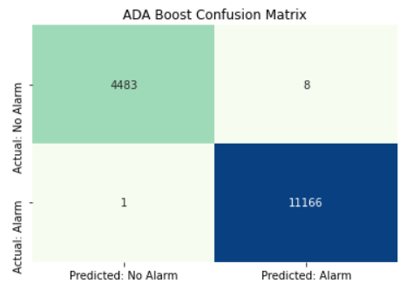
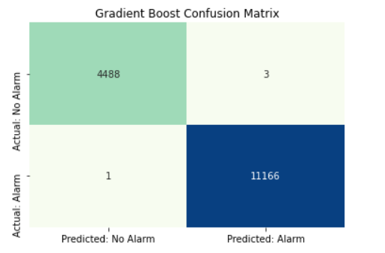
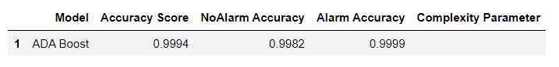
ADA Boost
Gradient Boost

Slide 11
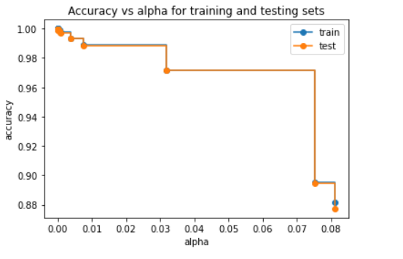
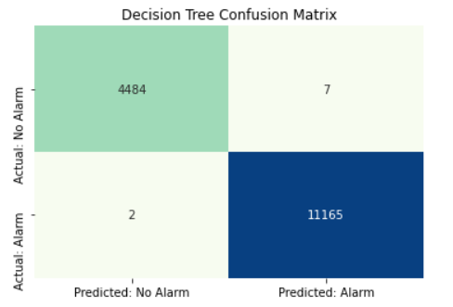
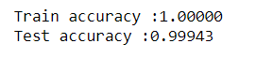
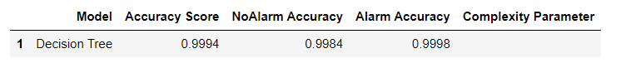
Decision Tree
Finding out the Cost complexity parameter to prune the tree
From the graph we could see at cp = 0 we could see best accuracy for both train and test sets . So we are setting cp to 0 , when building our decision tree
Results

Slide 12
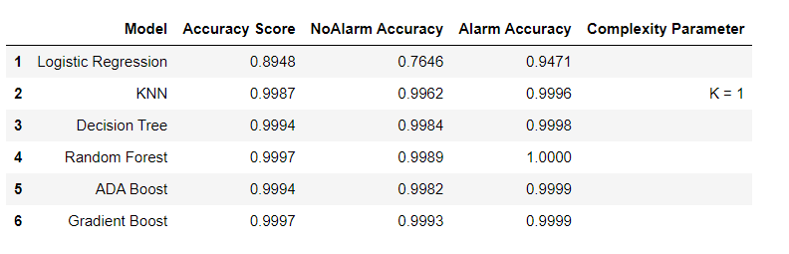
Results Summary
Conclusion
We can see the best accuracy for both ‘Random Forest’ and ‘Gradient Boosting’ models. But if we consider the time complexity of the model as well , ‘Random Forest’ will be the best model for this dataset.
Logistic regression performed poorly when compared. We did not balance the data , but we are able to see good results.

Slide 13
Thank You
Name | Email Id | UB Person Number
Soujan Vakulabharanam | soujanva@buffalo.edu | 50487440
Bharanidhar Reddy Marthala | bmarthal@buffalo.edu | 50479432
Sunil Kumar Madavaram | smadavar@buffalo.edu | 50461816

